Slide 1
TREATING PATIENTS WITH SYMPTOMATIC CERVICAL DISC DISEASE (SCDD)
Dr. _________________
[Name of Practice]
TG-187 rev 1 (05/2021)

Slide 2
Overview & Introduction
Neck Pain & Discomfort
What is Symptomatic Cervical Disc Disease (SCDD)?
Advancements in Treatment Options
When to Refer a Patient to a Spinal Surgeon
1
2
3
4
Treating Patients with Cervical Degenerative Disc Disease (DDD)
2
v

Slide 3
Neck Pain & Discomfort
Neck pain results when the spine is stressed by injury, disease, wear and tear, or poor body mechanics.
Neck pain has an annual prevalence rate exceeding 30% among adults in the US; nearly 50% of individuals will continue to experience some degree of chronic neck pain or frequent occurrences.¹
Most often caused by muscle strain which resolves with conservative care.
May also be caused by bulging/herniated disc pinching the nerve.
Only a small percentage of cases ultimately require surgery.
¹Symposium On Pain Medicine, 90, 2, P 284-299, February 1, 2015

Slide 4
Symptomatic Cervical Disc Disease (SCDD)
Healthy Disc
Neck or Arm (radicular) pain and/or a functional/neurological deficit with at least one of the following conditions recognized by imaging (CT, MRI, or X-Rays):
Herniated Nucleus Pulposus
Spondylosis (defined by the presence of osteophytes)
Loss of Disc Height
Degenerative Disc
Nerve Pressure

Slide 5
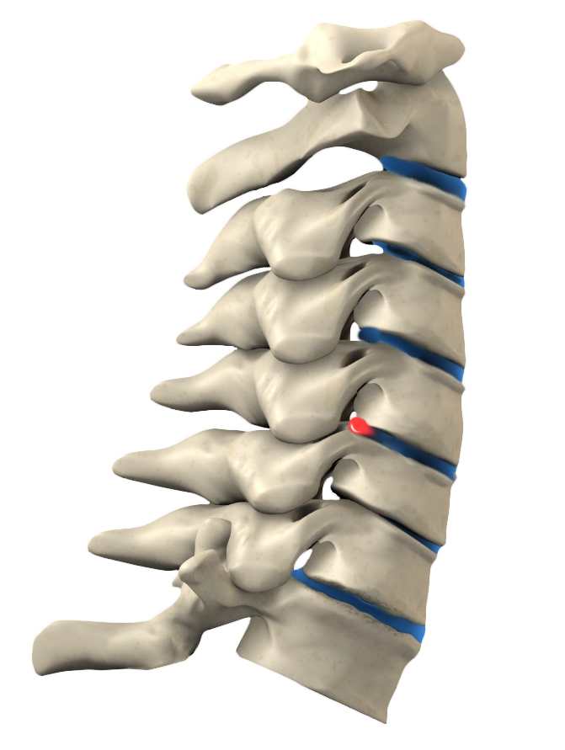
DDD Cascade
Normal Disc
Loss of Disc Height
Increased Instability
Change in Spinal Balance
Increased Load on the Facets/Ligaments
Formation of Osteophytes
Neck Pain and/or Nerve Pain
Degenerated Disc
Bulging Disc
Herniated Disc
Thinning Disc
Degenerated Disc with Osteophyte Formation

Slide 6
Interventional/DDD Cascade
SURGICAL INTERVENTION: FUSION
Regain Alignment
Removal of Pain Generator
Decompression of Neural Structures
Restore Disc Height
Stabilize Motion Segment
SURGICAL INTERVENTION: TDR
Maintains Motion
Regain Alignment
Removal of Pain Generator
Decompression of Neural Structures
Restore Disc Height
Stabilize Motion Segment
NON-INSTRUMENTED SURGERY
Removal of Pain Generator
Decompression of Neural Structures
MINIMALLY-INVASIVE CONSERVATIVE CARE
Disrupt Pain Generation
TIME
CONSERVATIVE CARE
Reduce Swelling
Restore Conditioning
Regain Alignment
Removal of Pain Generator
INCREASING PAIN & DEGENERATION

Slide 7
Conservative Care
Examples:
Physical Therapy
Chiropractic
Anti-inflammatories
Diet & Weight Loss
Exercise & Body Mechanics (posture)
Other Lifestyle Modifications
Treatment that does not require an incision or the removal of tissue.²
Goal: Reduce pain, provide conditioning, and manage existing conditions as conservatively as possible.²
2 https://www.spine-health.com/ glossary/conservative-treatment

Slide 8
Minimally-Invasive Conservative Care
Examples:
Facet joint injections/blocks
Epidural/steroid injections
Nerve root injections/blocks
The use of selective spinal injections in the treatment of spinal-related pain disorders.³
Goals:
The goal of the injection is pain/discomfort relief and/or reducing inflammation
Injection alone may be sufficient to provide relief
Commonly used in combination with a comprehensive rehabilitation program to provide additional benefit
³ Evidence-Based Clinical Guidelines for Multidisciplinary Spine Care: Diagnosis and Treatment of Degenerative Lumbar Spinal Stenosis. Burr Ridge, IL: North American Spine Society; 2011.

Slide 9
Non-Instrumented Surgery
Examples:
Foraminotomy
Laminectomy
Microdiscectomy
Surgical procedures that involve neural decompression without the need for instrumented stabilization.
Goals:
Decompression of neural structures
Removal or mitigation of pain generator

Slide 10
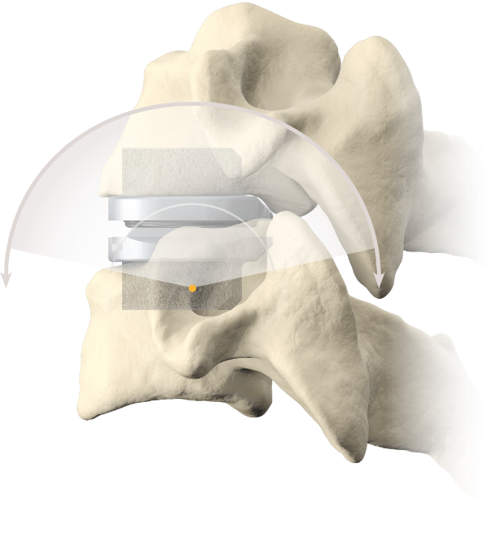
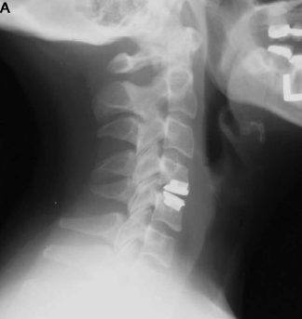
Surgical Intervention: Total Disc Replacement (TDR)
Involves removing the patient’s diseased disc and inserting a device that enables motion at the treated level.
Goals:
Remove pain generator
Neural decompression
Restore disc height
Stabilize motion segment
Enables motion

Slide 11
Surgical Intervention: Anterior Fusion
Examples:
ACDF (Anterior Cervical Discecomy & Fusion)
Stand-Alone ACDF
Involves removing the patient’s diseased disc and inserting a device that allows bone to grow between the vertebrae. The bone growth “fuses” the vertebrae together—providing stability by eliminating motion.
Goals:
Decompression of neural structures
Removal or mitigation of pain generator
Stabilize the painful motion segment

Slide 12
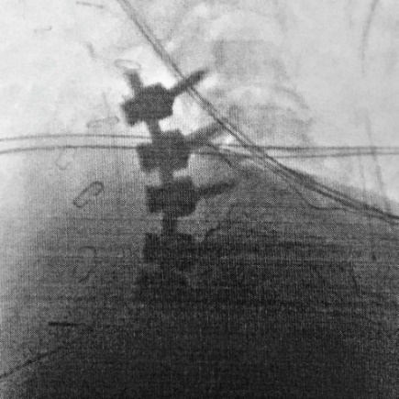
Surgical Intervention: Posterior Fusion
Examples:
PCF (Posterior Cervical Fusion)
Involves surgically fusing two or more cervical vertebrae together thru a posterior incision. Bone graft may be placed along the sides of the vertebrae or device to aid in the fusion process.
Goals:
Decompression of neural structures
Removal or mitigation of pain generator
Stabilize the painful motion segment

Slide 13
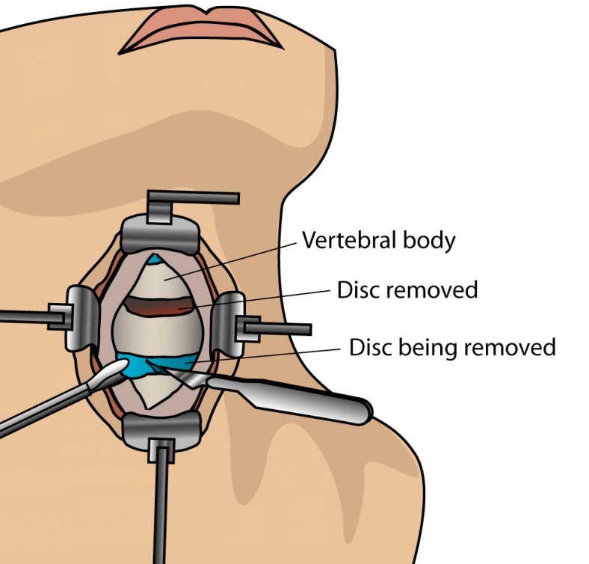
Anterior Approach
During cervical spinal surgery, the diseased spinal disc is removed.
Advantages to Using an Anterior Approach:
Muscle sparing with access for thorough removal of pain generator
Easier access to disc space for better discectomy
Less blood loss and shorter recovery time⁴
⁴ Yuk FJ, et al. Cureus. 2017 Jul 10;9(7):e1452.

Slide 14
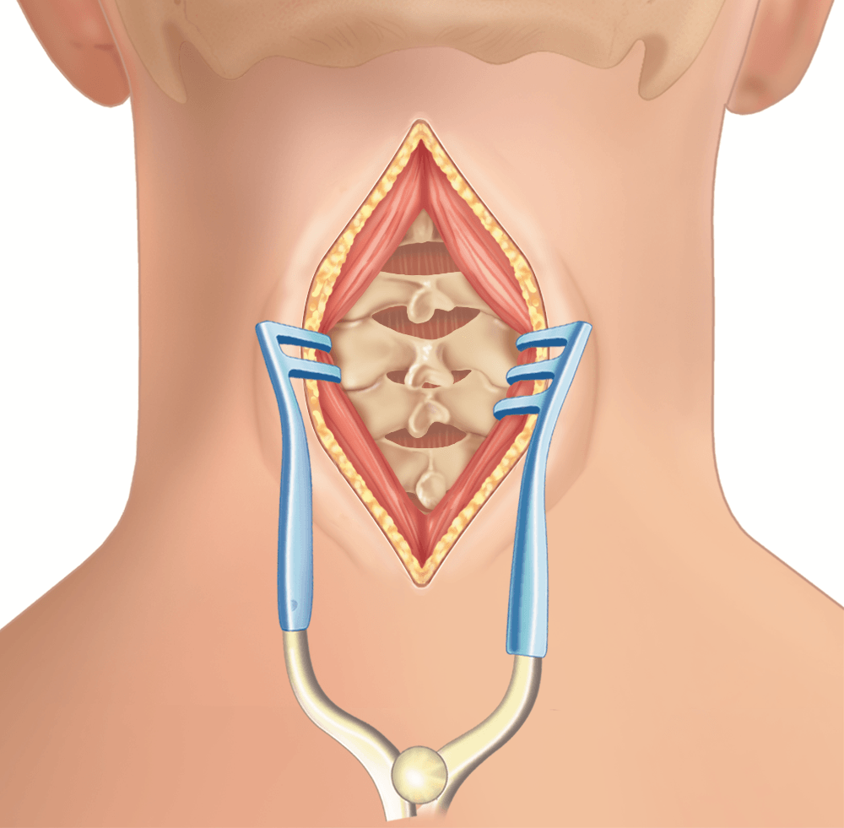
Posterior Approach
In the posterior fusion, the bone graft is placed on the backside of the vertebrae.
Advantages to Using a Posterior Approach:
Potential for additional stability
Ability to correct cervical spine deformity
Used for fractures and dislocations of cervical spine

Slide 15
Advancements in Instrumented Surgery (Surgical Interventions)
Total Disc Replacement (TDR)
Device that restores height, allows motion, restores balance, and provides stability to the cervical spine
Does not limit motion between vertebrae
Does not prevent utilization of fusion at a later date
Stand-Alone Cervical Interbody Fusion (SACIF)
Two or more vertebra are fused, or connected, via an instrumented interbody device to provide stable environment for a faster fusion without the need for additional fixation (i.e. plate)

Slide 16
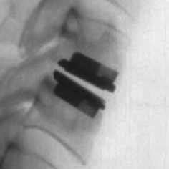
Surgical Intervention Advancements: TDR Benefits
Cervical disc replacement is a surgical procedure that involves removing a damaged or degenerated cervical disc and replacing it with an artificial disc device⁵
TDR allows for motion between two vertebrae to be maintained and avoids the need for a fusion⁵
5 “Artificial Disc Replacement” Wikipedia, Wikimedia Foundation, 15 Nov. 2021, https://­en.wikipedia.org/­wiki/­intervertebral_disc_arthroplasty.

Slide 17
Surgical Intervention Advancements: TDR Benefits
Anterior approach procedure
Maintain spinal balance and motion
Lower rate of re-operations⁷
Slows adjacent level degeneration⁷
Protects motion in adjacent segments
Restores disc height
Faster return to activities of daily living⁸
Reduced reliance on narcotics⁹
Strong Narcotic Usage (at 2 Years)⁶ | ACDF | TDR
 | 20.8% | 10%
REOPERATIONS
4x
FEWER
at 7 years compared to ACDF with a plate & cage⁷
INCIDENCES OF ADJACENT SEGMENT DISEASE
4x
FEWER
at 7 years compared to ACDF with a plate & cage²
⁶ Murrey, D., et al., The Spine Journal: official journal of the North American Spine Society, 2009. 9(4): p. 275-86. ⁷ Janssen ME, et al, JBJS 2015, 97:1738-47. ⁸ MCRA, MCRA break-down of Blue Health Intelligence Data: ACDF vs. Cervical Disc Arthroplasty Outcomes, 2012. ⁹ Janssen ME, et al. , JBJS 2015;97:1738-47.

Slide 18
Surgical Intervention Advancements: Stand-Alone ACDF Benefits
Traditionally, ACDF is the procedure of choice
50 years of clinical usage
Widely accepted technique
The goal of ACDF is to fuse two vertebrae, stabilize the spine, and prevent motion to¹⁰:
Eliminate pain – neck pain/arm pain
Preserve or enhance neurological function
Restore disc height
Provide segmental stability
10 “ACDF” Spine Universe, Remedy Health Media, 15 Nov. 2021, https://www.spineuniverse.com/resource-center/outpatient-spine-surgery/anterior-cervical-discectomy-fusion-acdf-outpatient-spine.

Slide 19
Cervical Fusion: Cage with Plate Vs. Stand-Alone
Plate & Interbody
Stand-Alone Interbody

Slide 20
Surgical Intervention Advancements: Stand-Alone ACDF Benefits
Stand-Alone
Stand Alone device—single device that replaces the diseased disc. The integrated device eliminates the profile found with traditional plating.
Benefits of the Stand-Alone Procedure (vs. traditional plate & cage)
Lower risk for dysphagia¹¹
Comparable Fusion Rates to Plate and Interbody¹²
Decreased Risk of Adjacent Segment Disease (ASD)¹¹
No device profile, minimizing disruption of the natural position of the esophagus
Reduced blood loss during procedure¹³
¹¹ Cheung, Z., et al. Global Spine Journal, 2019. 9(4): 446-455.
¹² Ghandi, SD., et al., Spine (Phila PA 1976), 2020 Jan 20.
¹³ Zhicheng, S., et al., World Neurosurg. 2018 Dec;120:e551-561.

Slide 21
Posterior Cervical Fusion (PCF)
A posterior cervical spine fusion surgery may be recommended to stop motion between two or more vertebrae, to straighten the cervical spine from a spinal deformity, or to stabilize the cervical spine after a fracture.¹⁴
Unlike in an anterior cervical fusion, there is no place to wedge bone graft, so the bone graft is simply laid on top of the lamina. The goal of surgery is for the lamina to eventually fuse.¹⁴
14 “Posterior Cervical Decompression” Spine Health.com, Veritas Health, November 16, 2021, https://www.spine-health.com/treatment/back-surgery/posterior-cervical-decompression-microdiscectomy-surgery

Slide 22
Benefits Comparison
 | TDR | ACDF (Stand-Alone) | ACDF (Plate & Cage) | PCF
Remove Pain Generators | ✓ | ✓ | ✓ | ✓
Neural Decompression | ✓ | ✓ | ✓ | ✓
Restore Disc Height | ✓ | ✓ | ✓ | ✓
Stabilize Motion Segment | ✓ | ✓ | ✓ | ✓
Restores Lordosis | ✓ | ✓ | ✓ | ✓
Restores Sagittal Balance | ✓ | ✓ | ✓ | ❌
Zero Profile | ✓ | ✓ | ❌ | ❌
Decrease Risk of Adjacent Segment Disease/Bridging Osteophytes^{15,16} | ✓ | ✓ | ❌ | ❌
Allow for Motion | ✓ | ❌ | ❌ | ❌
¹⁵Delamarter R, Zigler, Jl Spine 2013 Apr 20;38(9):711-7. ¹⁶ Yang H, et al. Arch Orthop Trauma Surg. 2015 Jun;135(6):781-7.

Slide 23
So When Should You Refer a Patient?
The Treatment option available to your patient is dependent upon when you refer them… the sooner the better!

Slide 24
Thank You!

